Slide 1
Role-Based Access Control
CS461/ECE422
Spring 2012

Slide 2
Reading Material
Chapter 4, sections 4.5 and 4.6
[SFK00]

Slide 3
DAC vs RBAC
DAC
Users, Groups → Permissions
RBAC
Roles → Permissions
Users → Roles
Many-to-many relations
Difference between groups and roles?
Groups: collection of users
Roles:
collection of permissions and/or users, and possibly other roles [S96]
job function within an organization [text]
Notes:
Objects == Rights == Permissions
Particular collection of users and permissions brought together by a role is transitory. The role is more stable because it reflects organizations functions and activities that change less frequently [SCFY96]. One force behind RBAC model is examination of current organizations → need to formalize relationships between users and permissions. Another force – standardization (NIST); no standard products on the market.
Access control was implemented by many systems, but we need the same mechanism for applications.
Example: helpdesk/operators may add/remove users to roles, but should not be able to define new roles
Many-to-many: scalability issues
Difference between groups and roles: UNIX example – determining file permissions

Slide 4






Basic RBAC Illustrated
Users
Roles
Permissions (Objects)
Relations:
Role 1
User
Assignment (UA)
Role 2
Permission Assignment (PA)
Role 3

Slide 5
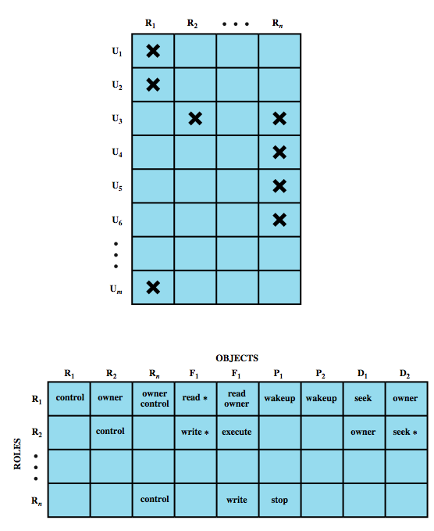
Access Matrix Representation
(Users, Roles)
(Roles, Objects)
- Similar to DAC ACM
- Roles can be Objects
Notes:
Roles can be object → Role hierarchies (discussed later)

Slide 6
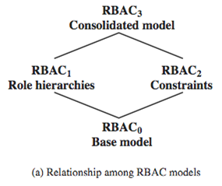
RBAC Reference Models [SCFY96]
RBAC₀
Minimum functionality
RBAC₁
RBAC₀ + Role hierarchies
RBAC₂
RBAC₀ + Constraints
RBAC₃
RBAC₀ + RBAC₁ + RBAC₂
Notes:
Easier to reason, platform for standardization. RBAC has been around for a while, but multiple commercial implementations are incompatible.
Directly supports desirable principles: least privilege (sessions), separation of duties (evident conflict of interest), data abstraction (abstract permissions; derive implementation-specific permissions from them)
RBAC1 and RBAC2 are called “advanced models” and incomparable between each other

Slide 7
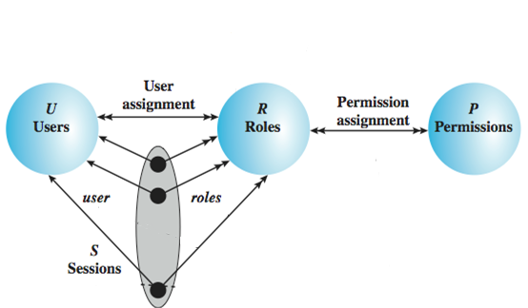
RBAC₀ – Base
Users: individuals with access to the system
Role: named job function within the org
Permission: approval of a particular mode of access to objects
Session: mapping between a user and a subset of roles
Notes:
Session example: UAC in Windows

Slide 8
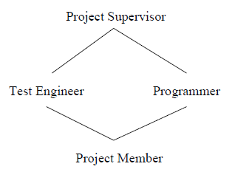
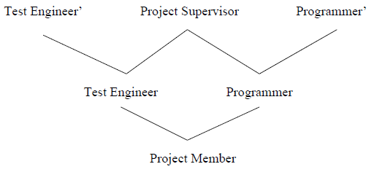
RBAC₁ – Role Hierarchies
Reflect hierarchical structure of roles in org
Mathematically, partial order (reflexive, transitive, anti-symmetric)
Example of Role Hierarchy
Limiting the scope of inheritance:
Role Hierarchy with private roles
Notes:
Convention: senior / more powerful roles are on top

Slide 9
RBAC₂ – Constraints
Reflect higher-level organizational policy
Mutually exclusive roles (U → R and R → P)
Cardinality – maximum number with respect to role
Prerequisite – can assign role only if already assigned prerequisite role
Remember, no hierarchies in RBAC₂

Slide 10
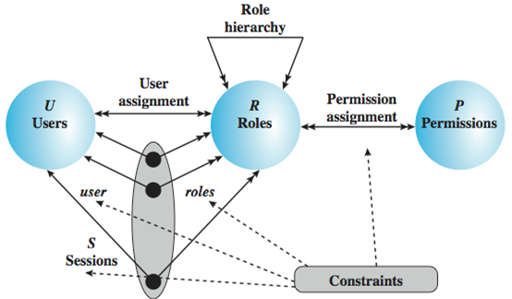
RBAC₃ – Consolidated Model
Notes:
Prerequisites are subsumed by roles hierarchies
Revisit role hierarchy example for mutual exclusion demonstration

Slide 11
NIST RBAC Model [SFK00]
RBAC System and Administrative Functional Specification
Three categories of features/functions:
Administrative functions: create, delete, maintain RBAC elements and relations
Supporting system functions: session management, access control decisions
Review functions: query operations on RBAC elements and relations
Four components: Core RBAC, Hierarchical RBAC, Static and Dynamic Separation of Duty (SSD, DSD)
Notes:
Builds on top of SAND96 and later research; approved in 2004. Consensus document, some features are left out.
Spec defines features required for an RBAC system + provides baseline

Slide 12
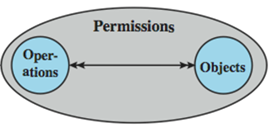
Core RBAC
Same as RBAC₀ (users, roles, permissions, sessions)
Object: any resource
Operation: executable image of a program
Permission: approval to perform an operation on object(s)
Administrative functions: add/delete users and roles, create/delete user-to-role and permission-to-role assignments
Supporting system functions: session ← create, add/delete role, check permission
Review functions: enable admin. to view entire model
Notes:
Also called Flat RBAC (level 1) in [SFK00].
Symmetric RBAC (Level 4): Must support permission-role review with performance effectively comparable to use-role review (text doesn’t say if Core RBAC requires “effectively comparable”), merged into this role in the standard (two mentioned review functions). This is an important distinction from DAC with groups.

Slide 13
Hierarchical RBAC
Similar to RBAC₁
r₁ is a descendant of r₂ if:
r₁ includes all permissions from r₂
All users assigned to r₁ are also assigned to r₂
General role hierarchies
Arbitrary partial order, multiple inheritance
Limited role hierarchies
Tree structure, single descendant allowed
Administrative functions: add/delete immediate inheritance relationship, create new role and add it as ascendant or descendant
Review functions: enable admin. to view users/permissions directly or by inheritance.
Notes:
Superior role is a descendant of a subordinate role (higher on the graph)
Rationale: similar to inheritance in OOP – overlapping permissions, organizational hierarchies
General hierarchies are more powerful, but limited hierarchies were also defined to recognize existing products w/ limited functionality

Slide 14
Static Separation of Duty (SSD)
Prevents conflict of interest
Cardinality constraint on a set of roles
SSD := (role set, n) where no user is assigned to n or more roles from the role set
Mutual exclusive roles as a special case:
SSD := ({r₁, r₂}, 2)
Administrative functions: create/delete role sets, add/delete role members
Review functions: view properties of SSD sets
Notes:
Both SSD and DSD are part of Constrained RBAC (Level 3) in [SFK00]
Example: Billing and Accounts Receivable clerks

Slide 15
Dynamic Separation of Duty (DSD)
Similar to SSD, but activated within sessions
Typically for temporal conflicts of interest
Definition
DSD := (role set, n) (n≥2) no user session may activate ≥n roles from role set
Example: Author and PC member (conference)
Administrative and review functions: similar to SSD

Slide 16
Unspecified by NIST RBAC
Scalability
Authentication
Negative permissions
Nature of permissions
Discretionary role activation
Role engineering
Constraints
RBAC administration
Role revocation
Notes:
Left to the implementation; but each implementation must carefully consider these issues

Slide 17
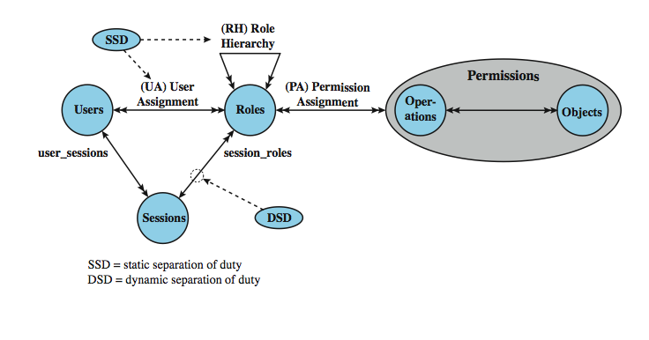
NIST Model Revisited

Slide 18
Role Engineering (RE)
Definition of roles can be difficult; essentially a requirements engineering process
RE is required to implement an abstract model
Basic process [C96]
Role prediction [Z+11]
Use statistical models to analyze audit logs
Predict roles, detect anomalies
Refine roles (generalize or split)
collect activities
group into
clusters
name
clusters
describe
remove duplicates
role candidates
simulate activities
identify minimal set of permissions

Slide 19
Case Study: RBAC for a Bank [SMJ01]
Prior to 1990 used local access control files
manually administered for each user, application, and host → administrative overhead, error-prone
Implemented RBAC scheme (Authorization)
Applications no longer make AC decisions; query Authorization for a security profile instead
Role := (official position, job function)
(different from NIST RBAC)
Notes:
Does not conform to RBAC96 or NIST RBAC
No concept of a session even though their model allows for multiple roles
Theoretically number of roles is quadratic, but practically many combinations do not occur.

Slide 20
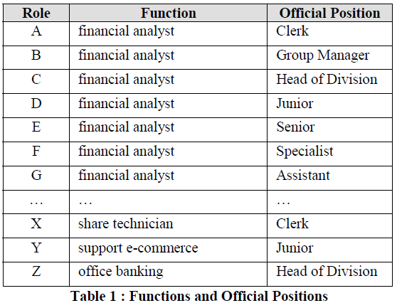
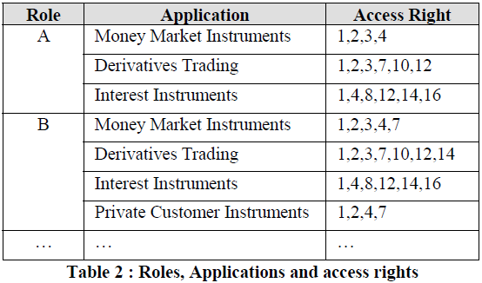
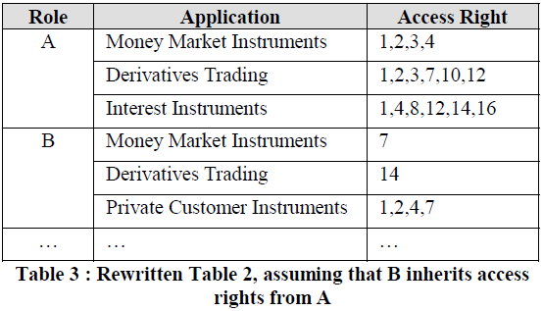

Slide 21
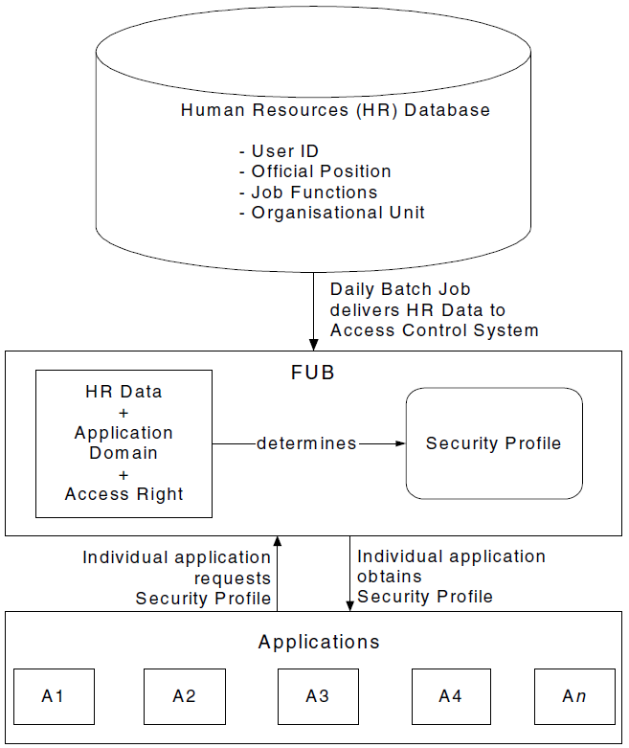
Architecture
Authorization
Notes:
High-level overview
When a user invokes an application, the application grants access on the basis of a centrally provided security profile. A separate authorization administration associated access rights with roles and creates the security profile for a use on the basis of the user's role.

Slide 22
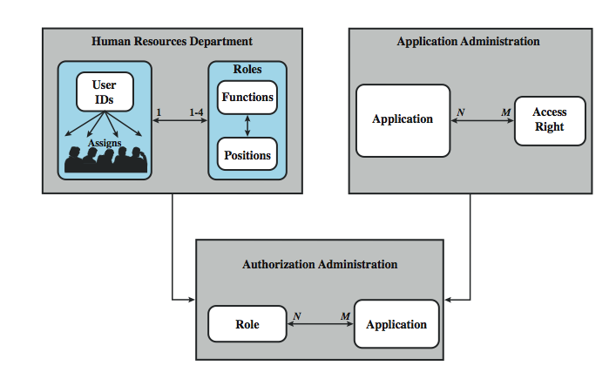
Role Administration
Notes:
• Human Resources Department
Role Definition and User/Role Assignment.
• Application Administration
Access Right Definition and Application/Access Right Assignment.
• Authorization Administration
Role/Application Assignment.
Users and application permissions are decoupled though roles, which makes their definition easier (HR know users, App Admins know applications)
Limitation: only FTEs are in the HR database and therefore are used as described; contractors have roles assigned directly in Authorization Administrtion

Slide 23
Numbers
65 official positions, 368 job functions
50,659 employees
1300 roles (potentially 23,920)
Agrees with estimate – #roles is 3-4% of #users
42,000 security profiles distributed daily

Slide 24
Key Points
Roles are collections of permissions, users, and possibly other roles (many-to-many)
Role hierarchies simplify RBAC management and can be derived from org structure
Constraints prevent conflict of interest
RBAC implementations simplify access control but may require role engineering

Slide 25
References
[SCFY96] Sandhu, R., et al. “Role-Based Access Control Models.” Computer, 1994.
[S96] Sandhu, R. Roles versus groups. In Proceedings of the first ACM Workshop on Role-based access control (RBAC '95)
[SFK00] Sandhu, R., Ferraiolo, D.F. and Kuhn, D.R. (July 2000). "The NIST Model for Role Based Access Control: Toward a Unified Standard". 5th ACM Workshop Role-Based Access Control (RBAC ‘00)
[C96] Coyne, E. Role engineering. In Proceedings of the first ACM Workshop on Role-based access control (RBAC '95)
[Z+11] Role Prediction using Electronic Medical Record System Audits Wen Zhang, Carl A. Gunter, David Liebovitz, Jian Tian, and Bradley Malin AMIA 2011 Annual Symposium, Washington, DC, October 2011
[SMJ01] Andreas Schaad, Jonathan Moffett, and Jeremy Jacob. 2001. The role-based access control system of a European bank: a case study and discussion. In Proceedings of the sixth ACM symposium on Access control models and technologies (SACMAT '01)

